Slide 1

Notes:
In the interest of the fact that you all have had a long day, this talk is going to be less about giving you answers, and more about asking you intriguing questions to motivate you and go read up interesting stuff. So be prepared for interesting questions about artificial intelligence, some really cool demos, and some awesome optical illusions!
I’d like to begin with a short clip.
Now that we have seen the importance of vision, How do we give Wall the power of sight? What are the challenges we can face, and how do we address them?

Slide 2

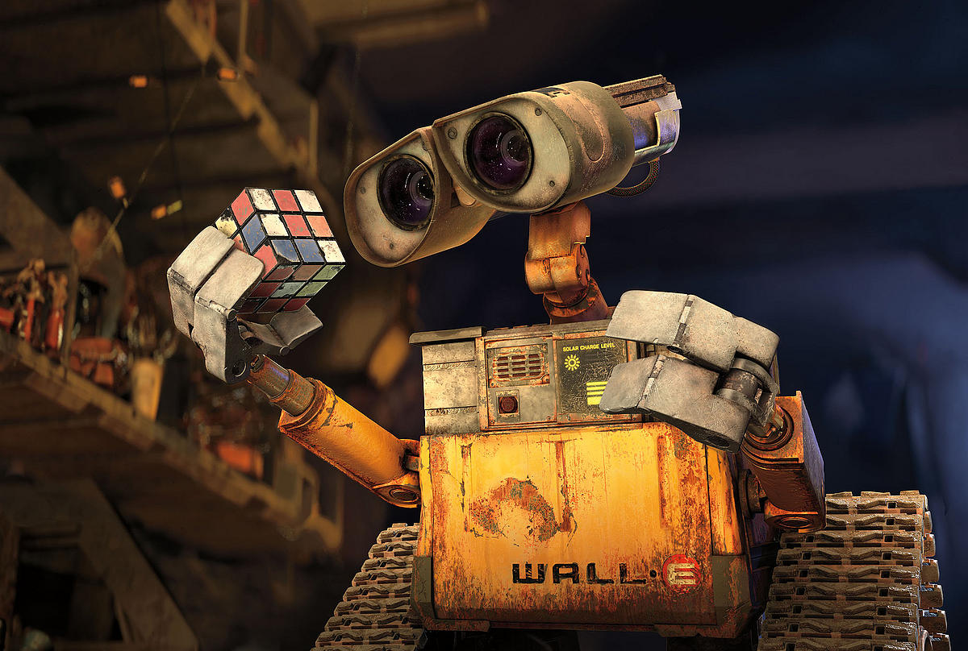
How do we make Wall-E capable of seeing the world around him?
Notes:
Just looking at these pictures what are the capabilities wall-e must have – 1) He needs to know that he’s looking at a person, as he’s saying Hi. 2) He needs to know he’s holding a rubik’s cube. And at that, an unsolved one. So we can see, that the capability of vision can be divided into a number of interesting questions – Identifying objects, identifying people (as facebook does when it lets you tag your friends).
This brings us to our next problem - What are some important components of computer vision? And why is it so challenging to make these components

Slide 3
Some important components of Vision
Detecting Objects – Like finding a chair?
Identifying people?
Understanding what’s happening in a scene?
Understanding Color?
…. And Many More

Slide 4
So what makes these SO hard?
Notes:
In order to best appreciate the toughness of the problem, let’s have you try and perform these tasks. After all, you have a better visual system in your eyes than any computer in the world!

Slide 5
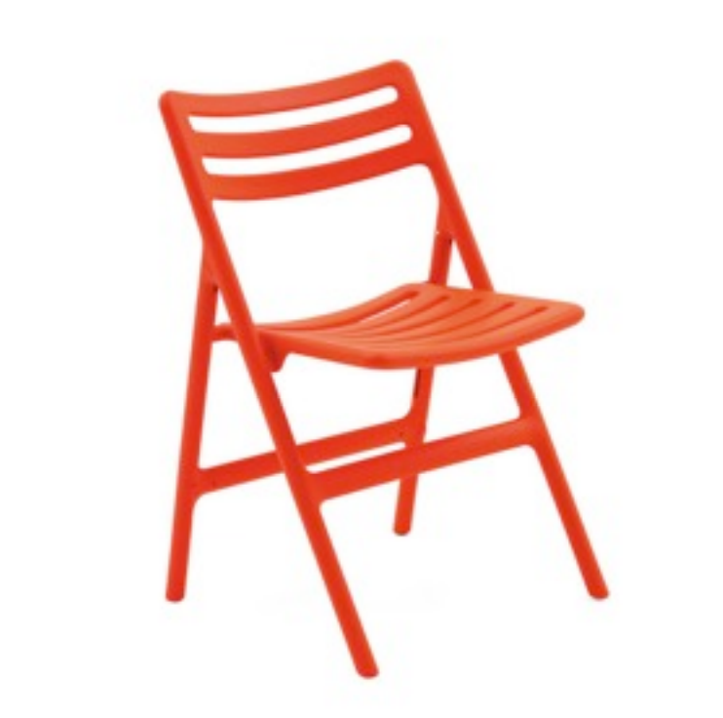
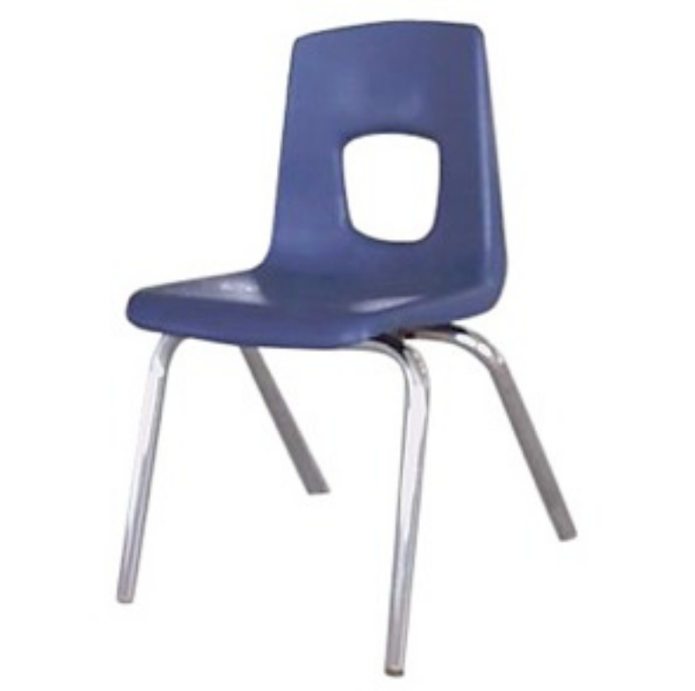
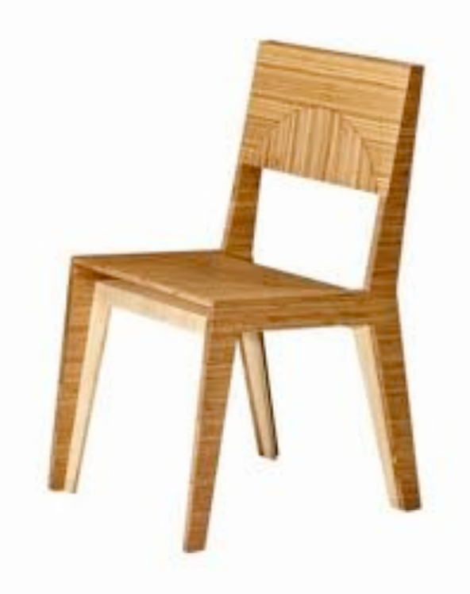
Challenge 1: help a robot recognize a chair
Notes:
If you want to teach a robot how to recognize a chair. How would you teach it what a chair is. Any ideas?

Slide 6
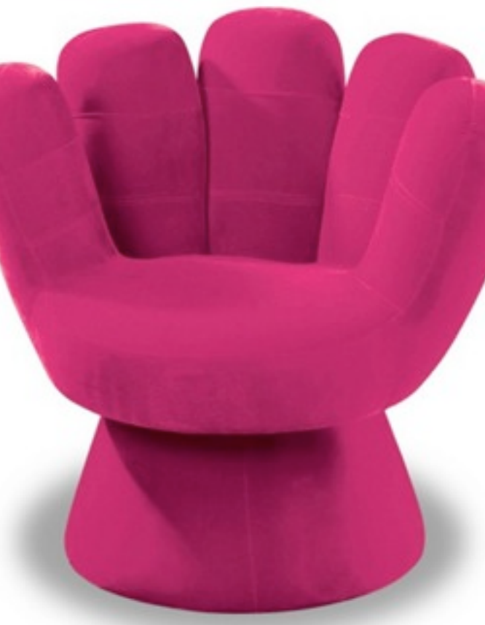
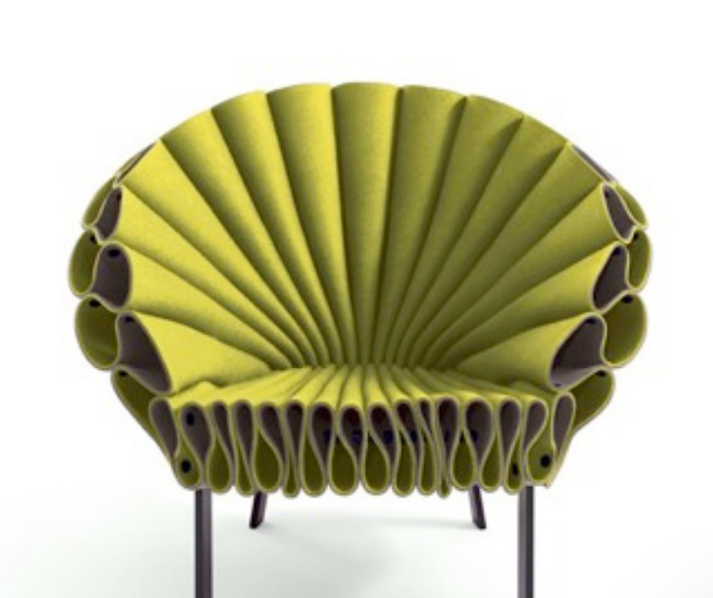
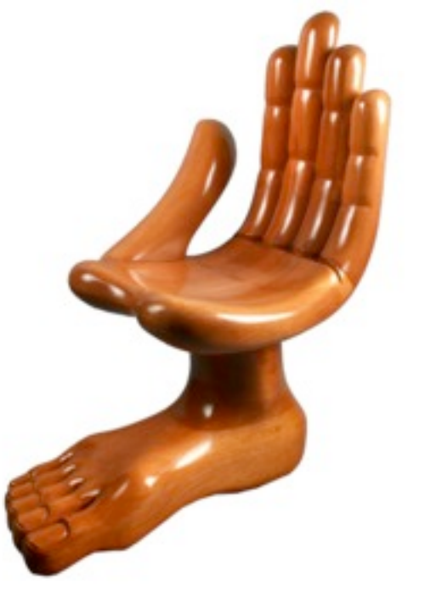
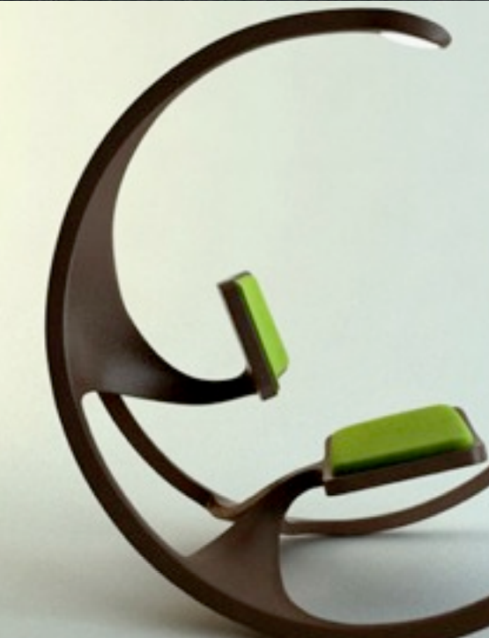
But… aren’t these also chairs? :/
Shape definitely doesn’t seem to work
Maybe, it’s a surface on the ground that we sit on?
Notes:
But then, how do we account for these cases?
So, do we redefine to make it more general?

Slide 7
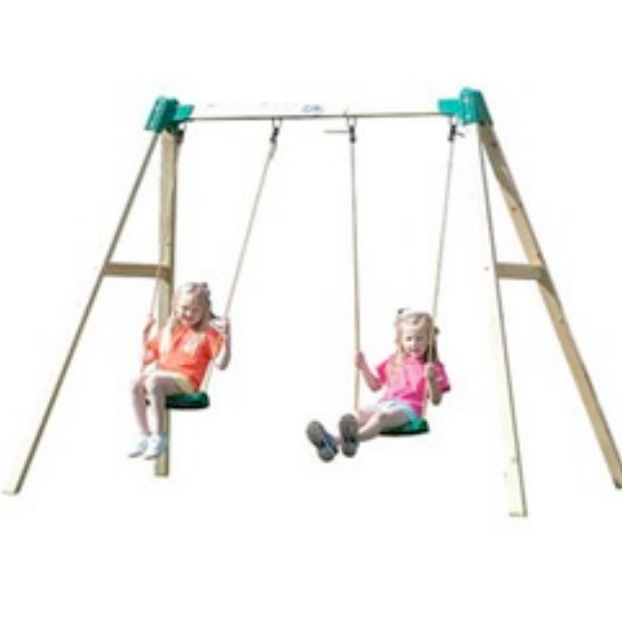


Naah, this does doesn’t work either – None of these are chairs!
Surface on the ground used to sit?
Notes:
This brings us to the question, how do we really go about solving it?
So first up, let’s see the disconnect. What do we see, and what does the computer see?

Slide 8
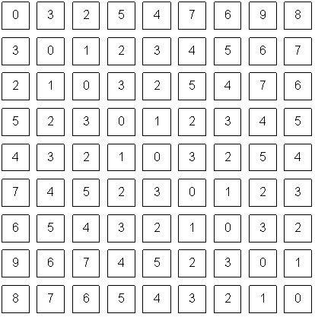

What we see v/s What Wall-E sees Making sense of Pixel Values
V/S
Notes:
The power of creating artificial vision, is called as computer vision. And the field began right here, at MIT. If you join MIT,
Well it starts from right here, at MIT.
And if you join MIT and take the class on AI or vision, you’ll get to know the whole story in detail ☺ But,

Slide 9
A bit of Magic and A whole lot of Math

Slide 10
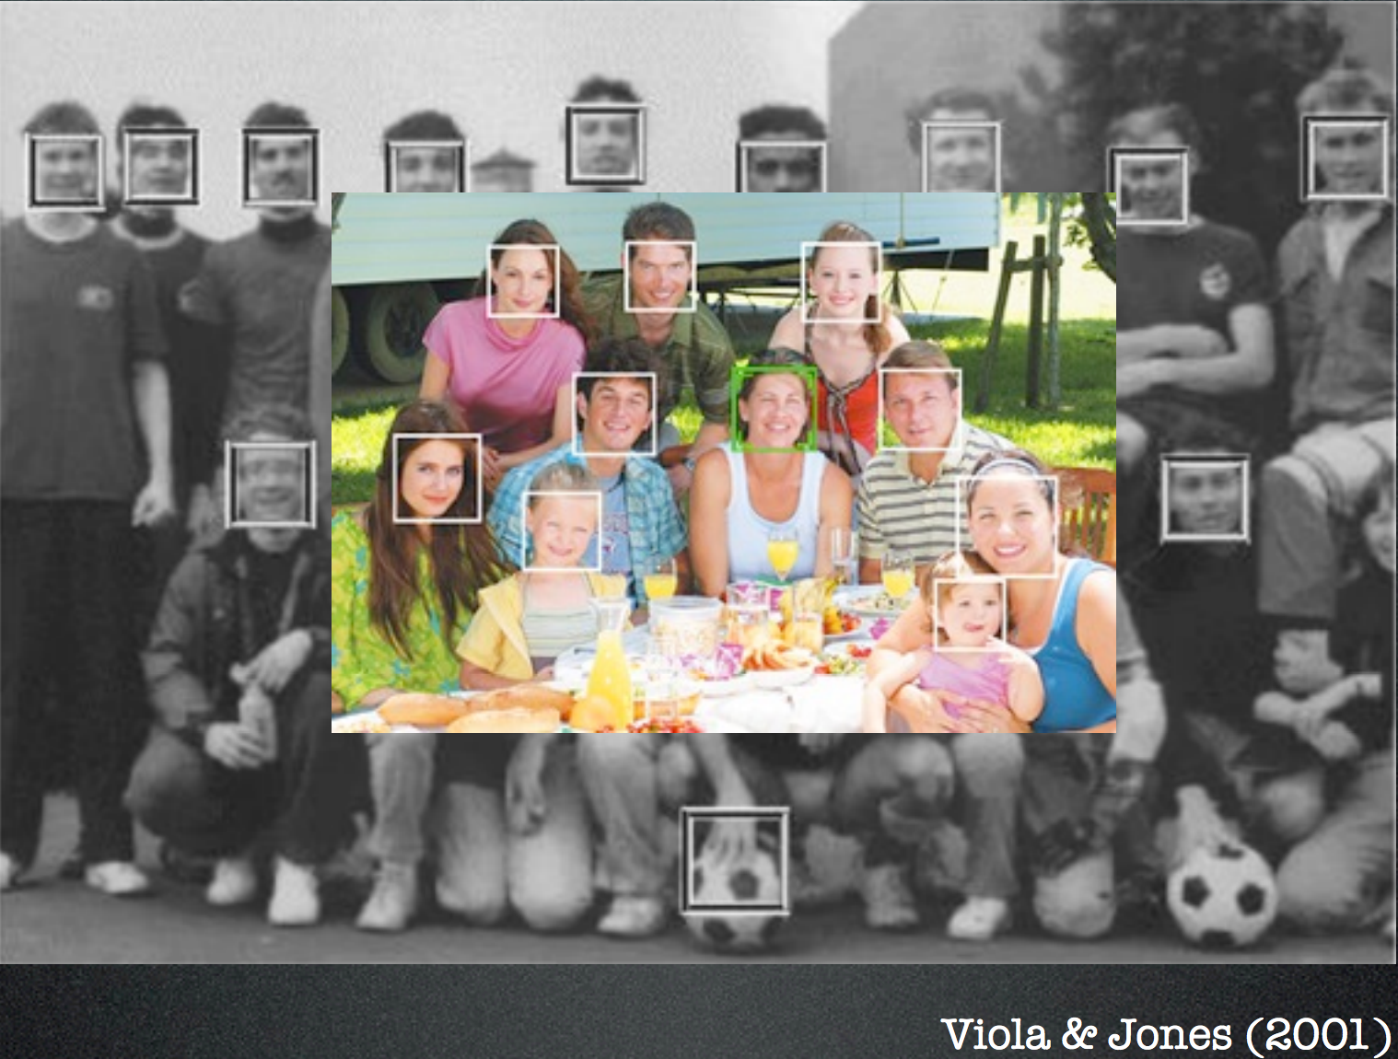
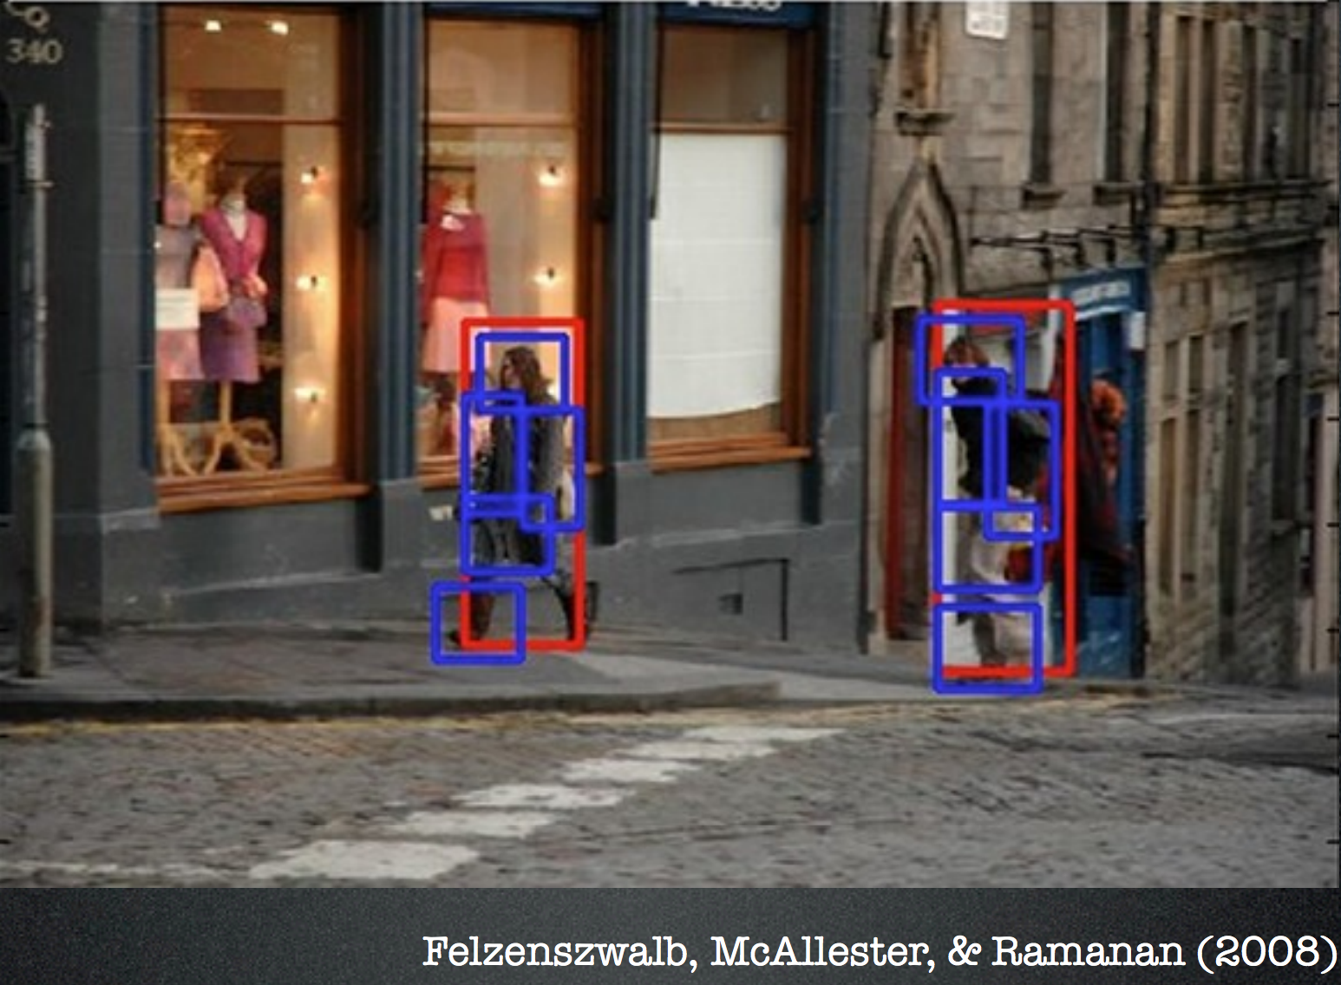
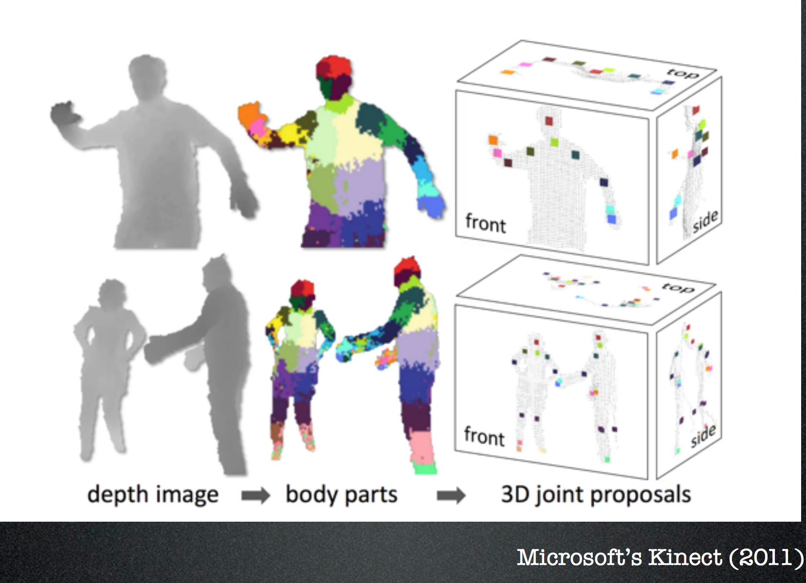

Let’s see some of the big successes in the field?

Slide 12
Let’s see a Demo?

Slide 13
Can I get this code?

